Slide 1
CAP275: Data Communication and Networking Unit-2: Physical Layer - Line Coding
Dr. Manmohan Sharma
School of Computer Applications
Lovely Professional University

Slide 2
DIGITAL-TO-DIGITAL CONVERSION
The conversion involves three techniques:
line coding
block coding
Scrambling
Line coding is always needed
block coding and scrambling may or may not be needed

Slide 3
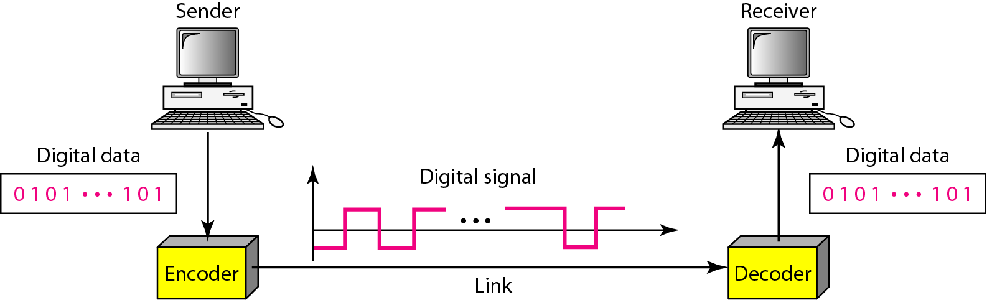
Line Coding
A line code is the code used for data transmission of a digital signal over a transmission line. This process of coding is chosen so as to avoid overlap and distortion of signal such as inter-symbol interference.
Converting a string of 1’s and 0’s (digital data) into a sequence of signals that denote the 1’s and 0’s.
For example a high voltage level (+V) could represent a “1” and a low voltage level (0 or -V) could represent a “0”.

Slide 4
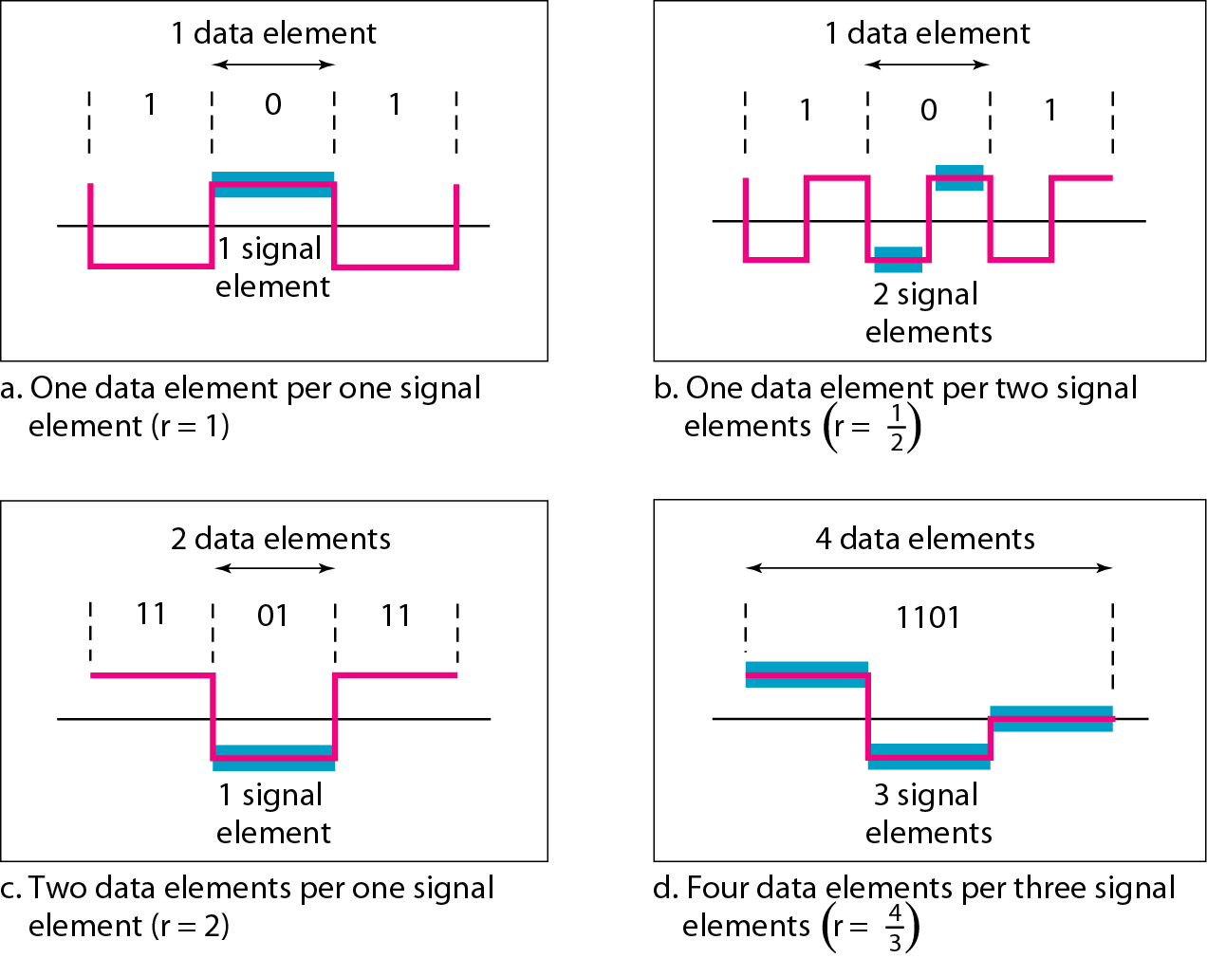
Signal element versus data element

Slide 5
Data Rate v/s Signal Rate
The data rate defines the number of bits sent per sec - bps. It is often referred to the bit rate.
The signal rate is the number of signal elements sent in a second and is measured in bauds. It is also referred to as the pulse rate, modulation rate or baud rate.
Goal is to increase the data rate while reducing the baud rate.

Slide 6
Line Coding Schemes
There are 3 types of Line Coding
Unipolar
Polar
Bi-polar

Slide 7
Unipolar
All signal levels are on one side of the time axis - either above or below. Unipolar signaling is also called as On-Off Keying or simply OOK.
The presence of pulse represents a 1 and the absence of pulse represents a 0.
There are two variations in Unipolar signaling −
Non Return to Zero (NRZ)
Return to Zero (RZ)

Slide 8
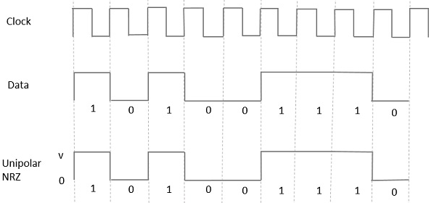
Unipolar NRZ scheme

Slide 9
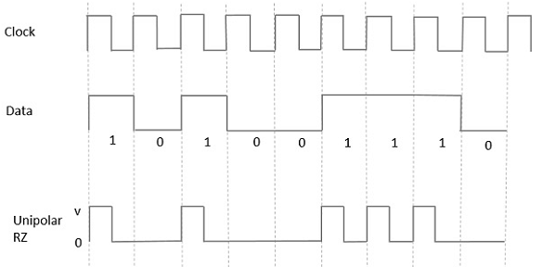
Unipolar RZ scheme

Slide 10
Polar-NRZ
The voltages are on both sides of the time axis.
Polar NRZ scheme can be implemented with two voltages. E.g. +V for 1 and -V for 0.
There are two versions:
NZR - Level (NRZ-L) - positive voltage for one symbol and negative for the other
NRZ - Inversion (NRZ-I) - the change or lack of change in polarity determines the value of a symbol. E.g. a “1” symbol inverts the polarity a “0” does not.

Slide 11
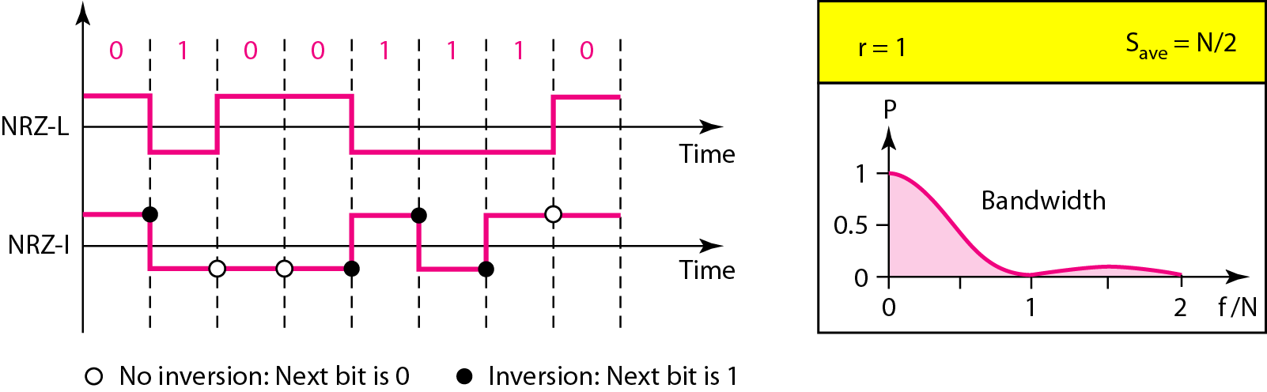
Figure 4.6 Polar NRZ-L and NRZ-I schemes

Slide 12

Note
In NRZ-L the level of the voltage determines the value of the bit. In NRZ-I the inversion or the lack of inversion determines the value of the bit.

Slide 13
Note
NRZ-L and NRZ-I both have an average signal rate of N/2 Bd.

Slide 14
Note
NRZ-L and NRZ-I both have a DC component problem and baseline wandering, it is worse for NRZ-L. Both have no self synchronization & no error detection. Both are relatively simple to implement.

Slide 15
Polar - RZ
The Return to Zero (RZ) scheme uses three voltage values. +, 0, -.
Each symbol has a transition in the middle. Either from high to zero or from low to zero.
This scheme has more signal transitions (two per symbol) and therefore requires a wider bandwidth.
No DC components or baseline wandering.
Self synchronization - transition indicates symbol value.
More complex as it uses three voltage level. It has no error detection capability.

Slide 16
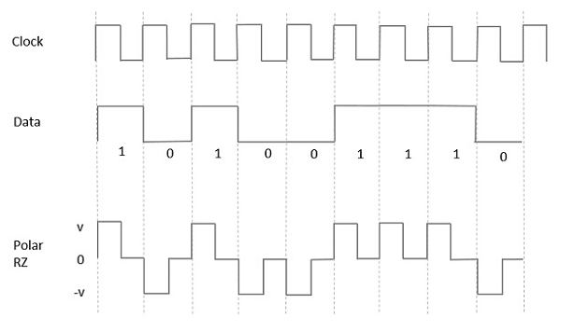
Polar RZ scheme

Slide 17
Polar - Biphase: Manchester and Differential Manchester
Manchester coding consists of combining the NRZ-L and RZ schemes.
Every symbol has a level transition in the middle: from high to low or low to high. Uses only two voltage levels.
Differential Manchester coding consists of combining the NRZ-I and RZ schemes.
Every symbol has a level transition in the middle. But the level at the beginning of the symbol is determined by the symbol value. One symbol causes a level change the other does not.

Slide 18
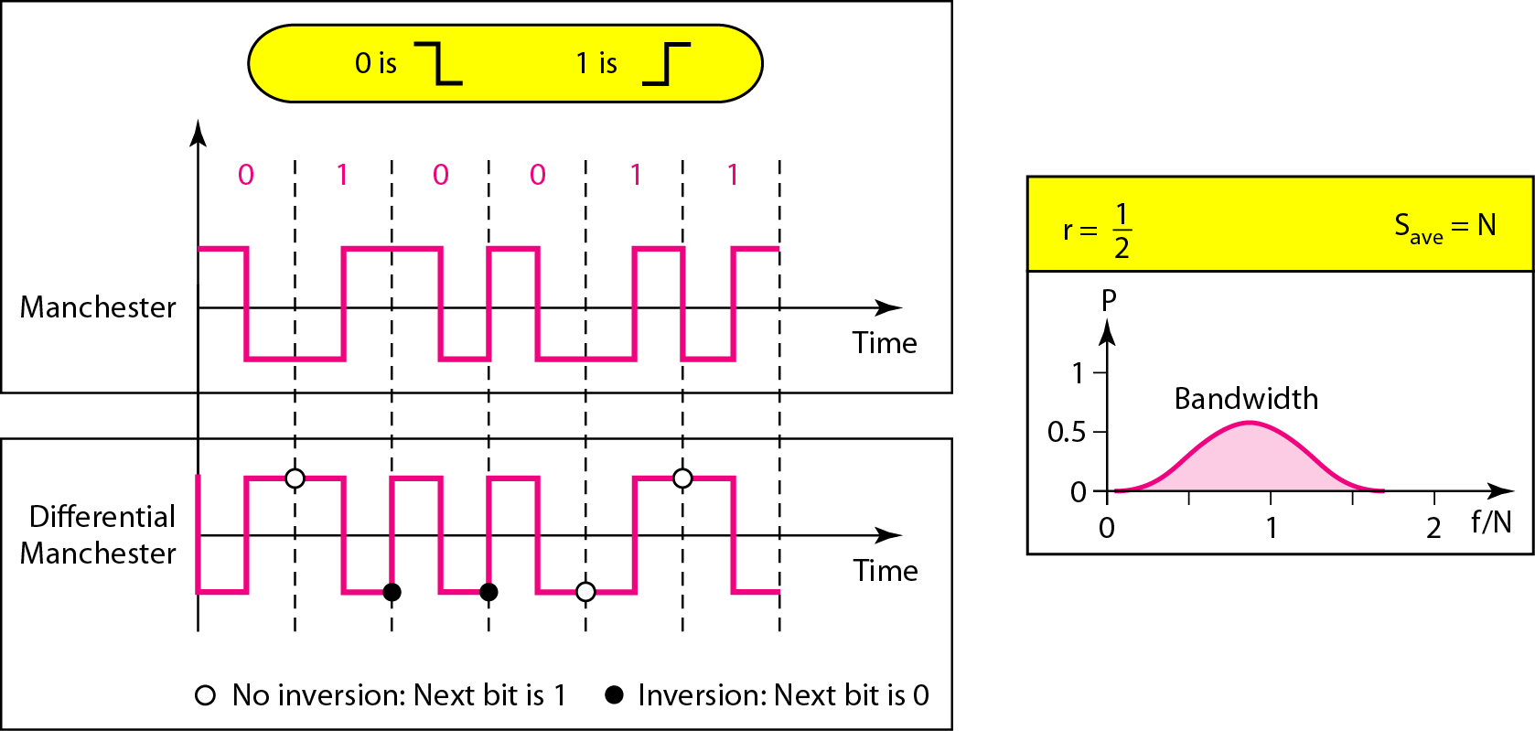
Figure 4.8 Polar biphase: Manchester and differential Manchester schemes

Slide 19
Note
In Manchester and differential Manchester encoding, the transition
at the middle of the bit is used for synchronization.

Slide 20
Note
The minimum bandwidth of Manchester and differential Manchester is 2 times that of NRZ. The is no DC component and no baseline wandering. None of these codes has error detection.

Slide 21
Bipolar - AMI and Pseudoternary
Code uses 3 voltage levels: +, 0, -, to represent the symbols (note: no transitions to zero as in RZ).
Voltage level for one symbol is at “0” and the other alternates between + & -.
Bipolar Alternate Mark Inversion (AMI): the “0” symbol is represented by zero voltage and the “1” symbol alternates between +V and -V.
Pseudoternary is the reverse of AMI.

Slide 22
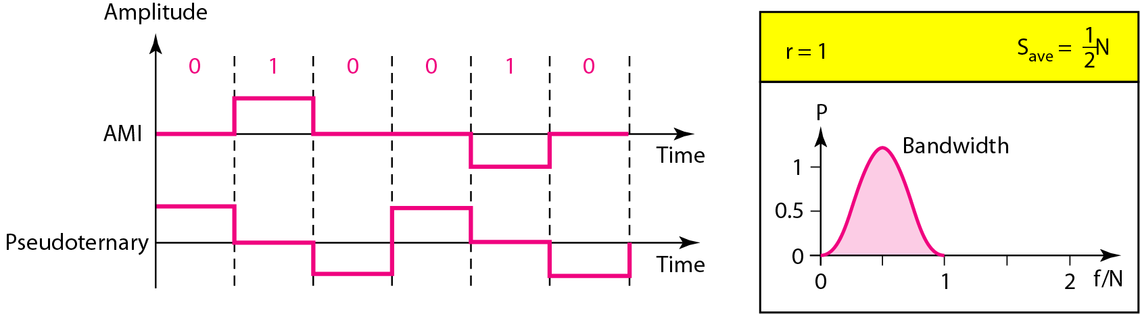
Figure 4.9 Bipolar schemes: AMI and pseudoternary

Slide 23
Block Coding
For a code to be capable of error detection, we need to add redundancy, i.e., extra bits to the data bits.
Synchronization also requires redundancy - transitions are important in the signal flow and must occur frequently.
Block coding is done in three steps: division, substitution and combination.
It is distinguished from multilevel coding by use of the slash xb/yB.
The resulting bit stream prevents certain bit combinations that when used with line encoding would result in DC components or poor sync. quality.

Slide 24
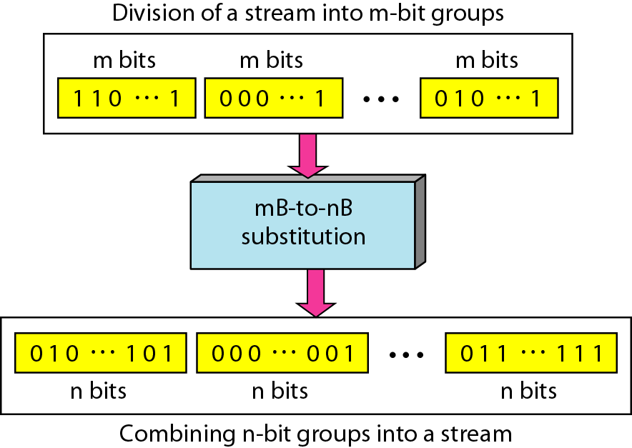
Block coding is normally referred to as mB/nB coding; it replaces each m-bit group with an n-bit group.

Slide 25
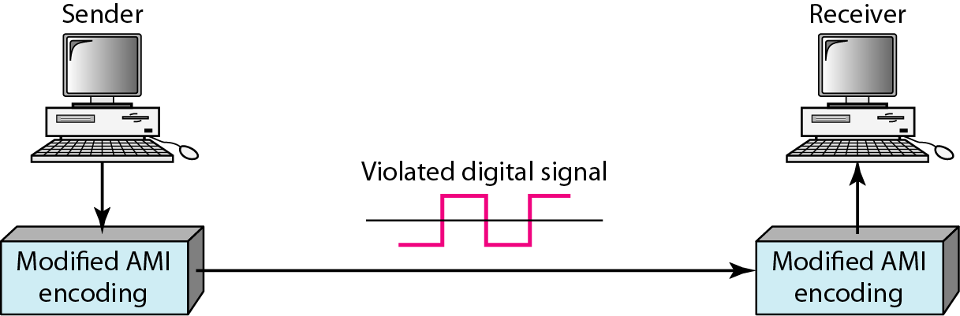
Scrambling
The best code is one that does not increase the bandwidth for synchronization and has no DC components.
Scrambling is a technique used to create a sequence of bits that has the required characteristics for transmission - self clocking, no low frequencies, no wide bandwidth.
It is implemented at the same time as encoding, the bit stream is created on the fly.
It replaces ‘unfriendly’ runs of bits with a violation code that is easy to recognize and removes the unfriendly characteristics.

Slide 26
For example: B8ZS substitutes eight consecutive zeros with 000VB0VB.
The V stands for violation, it violates the line encoding rule
B stands for bipolar, it implements the bipolar line encoding rule

Slide 27
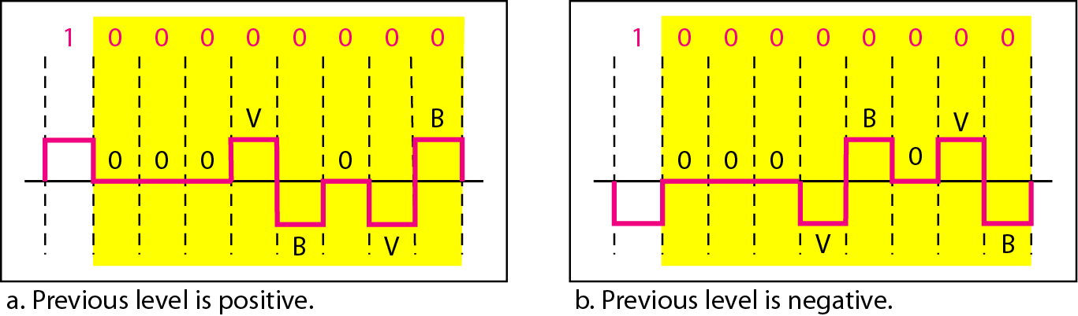
Figure 4.19 Two cases of B8ZS scrambling technique

Slide 28
HDB3 substitutes four consecutive zeros with 000V or B00V depending on the number of nonzero pulses after the last substitution.
If number of non zero pulses is even the substitution is B00V to make total number of non zero pulse even.
If number of non zero pulses is odd the substitution is 000V to make total number of non zero pulses even.

Slide 29
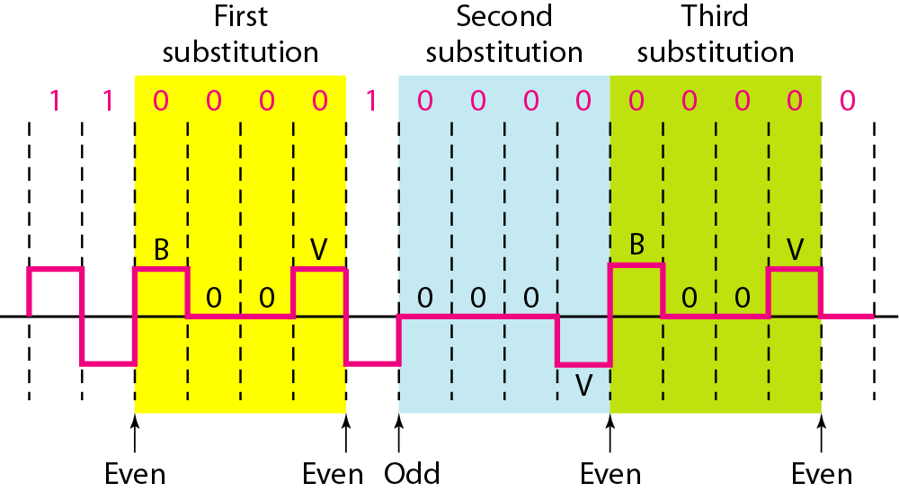
Figure 4.20 Different situations in HDB3 scrambling technique

Slide 30
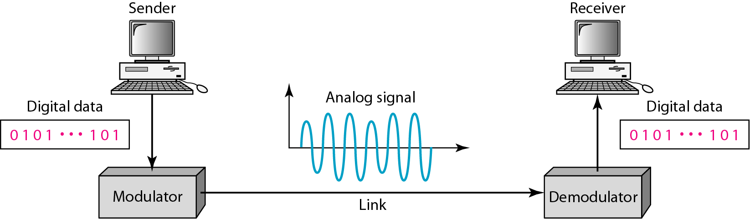
Digital to Analog Conversion
Digital data needs to be carried on an analog signal.
A carrier signal (frequency f_{c}) performs the function of transporting the digital data in an analog waveform.
The analog carrier signal is manipulated to uniquely identify the digital data being carried.

Slide 31
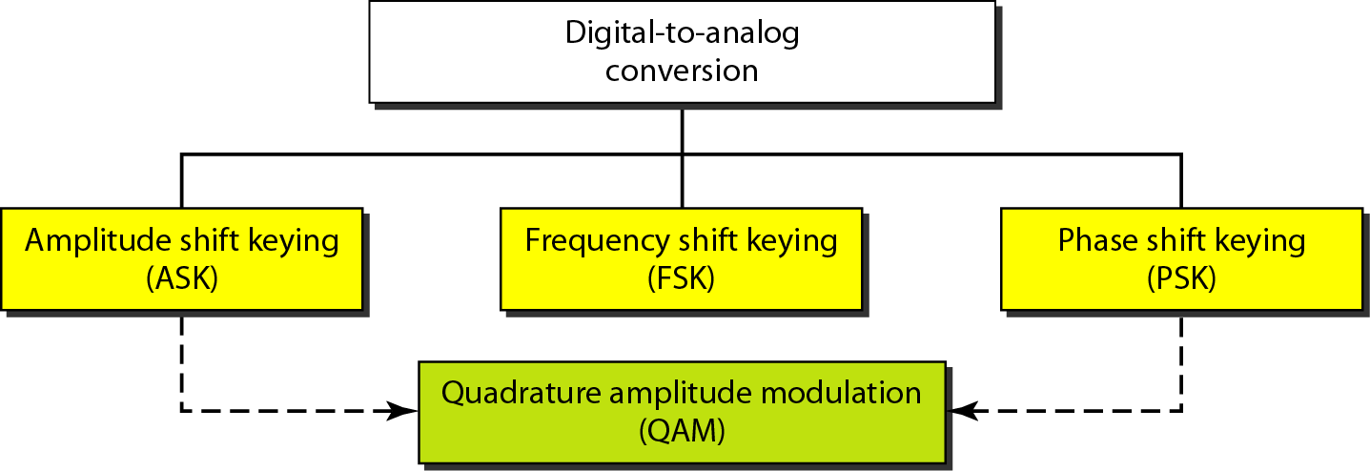
Types of Digital-to-Analog Conversion

Slide 32
Note
Bit rate, N, is the number of bits per second (bps).
Baud rate is the number of signal elements per second (bauds).
In the analog transmission of digital data, the signal or baud rate is less than or equal to the bit rate.
S=Nx1/r bauds
Where r is the number of data bits per signal element.

Slide 33
An analog signal carries 4 bits per signal element. If 1000 signal elements are sent per second, find the bit rate.
Solution
In this case, r = 4, S = 1000, and N is unknown. We can find the value of N from

Slide 34
An analog signal has a bit rate of 8000 bps and a baud rate of 1000 baud. How many data elements are carried by each signal element? How many signal elements do we need?
Solution
In this example, S = 1000, N = 8000, and r and L are unknown. We find first the value of r and then the value of L.

Slide 35
Amplitude Shift Keying (ASK)
ASK is implemented by changing the amplitude of a carrier signal to reflect amplitude levels in the digital signal.
For example: a digital “1” could not affect the signal, whereas a digital “0” would, by making it zero.
The line encoding will determine the values of the analog waveform to reflect the digital data being carried.
Bandwidth of ASK
The bandwidth B of ASK is proportional to the signal rate S.
B = (1+d)S
“d” is due to modulation and filtering, lies between 0 and 1.

Slide 36
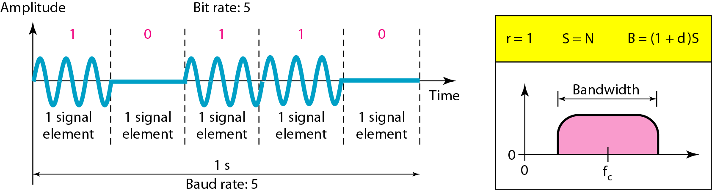
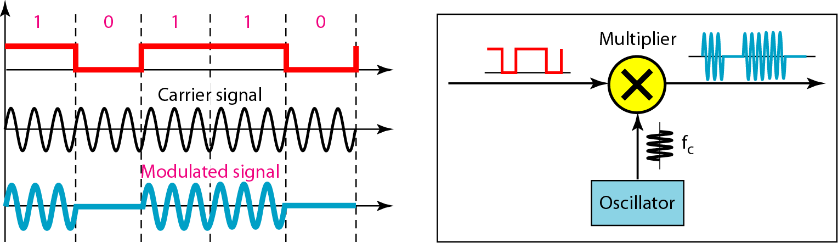
Binary Amplitude Shift Keying

Slide 37
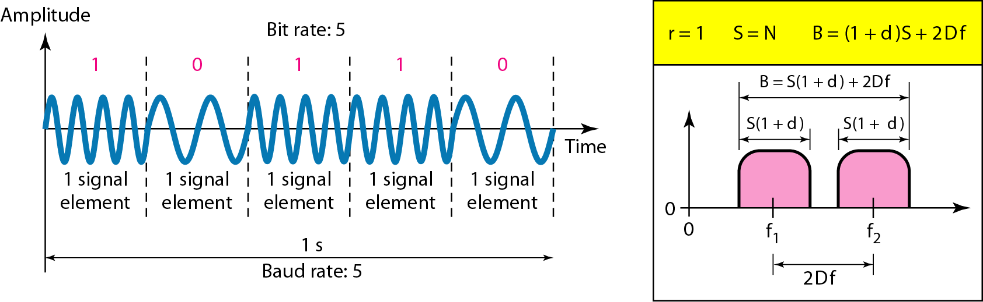
Frequency Shift Keying
The digital data stream changes the frequency of the carrier signal, f_{c}.
For example, a “1” could be represented by f₁=f_{c} +Δf, and a “0” could be represented by f₂=f_{c}-Δf.
Bandwidth of ASK
If the difference between the two frequencies (f₁ and f₂) is 2Δf, then the required BW B will be:
B = (1+d)xS +2Δf

Slide 38
We have an available bandwidth of 100 kHz which spans from 200 to 300 kHz. What should be the carrier frequency and the bit rate if we modulated our data by using FSK with d = 1?
Solution
This problem is similar to Example 5.3, but we are modulating by using FSK. The midpoint of the band is at 250 kHz. We choose 2Δf to be 50 kHz; this means

Slide 39
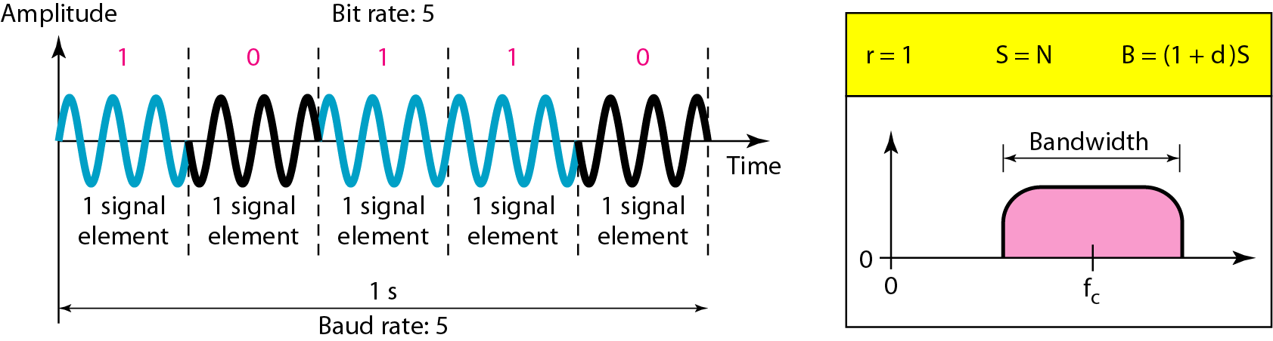
Phase Shift Keyeing
We vary the phase shift of the carrier signal to represent digital data.
The bandwidth requirement, B is:
B = (1+d)xS
PSK is much more robust than ASK as it is not that vulnerable to noise, which changes amplitude of the signal.

Slide 40
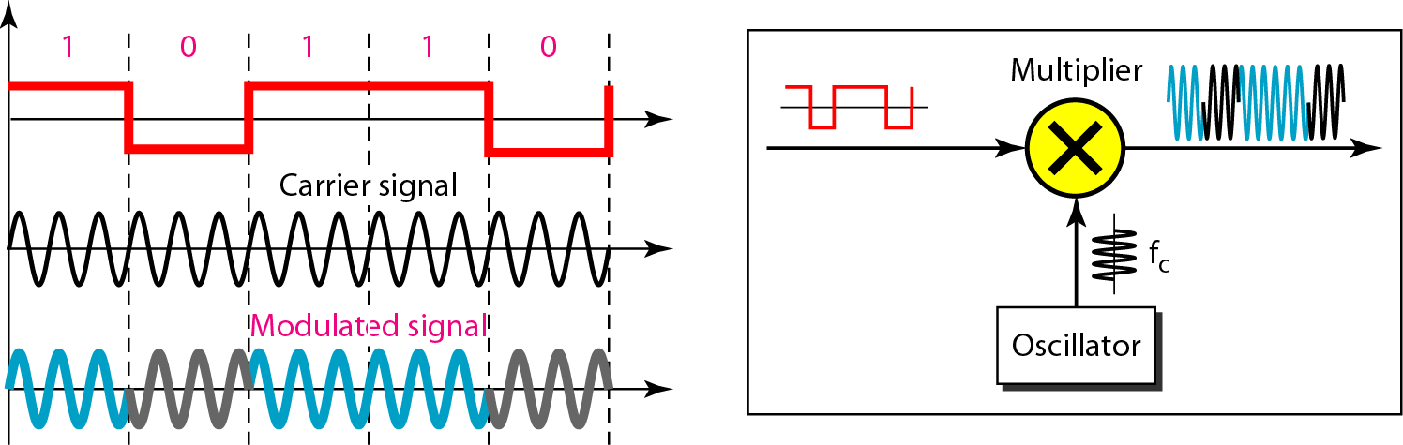
Figure 5.10 Implementation of BASK

Slide 41
Quadrature PSK
To increase the bit rate, we can code 2 or more bits onto one signal element.
In QPSK, we parallelize the bit stream so that every two incoming bits are split up and PSK a carrier frequency. One carrier frequency is phase shifted 90º from the other - in quadrature.
The two PSKed signals are then added to produce one of 4 signal elements. L = 4 here.

Slide 42
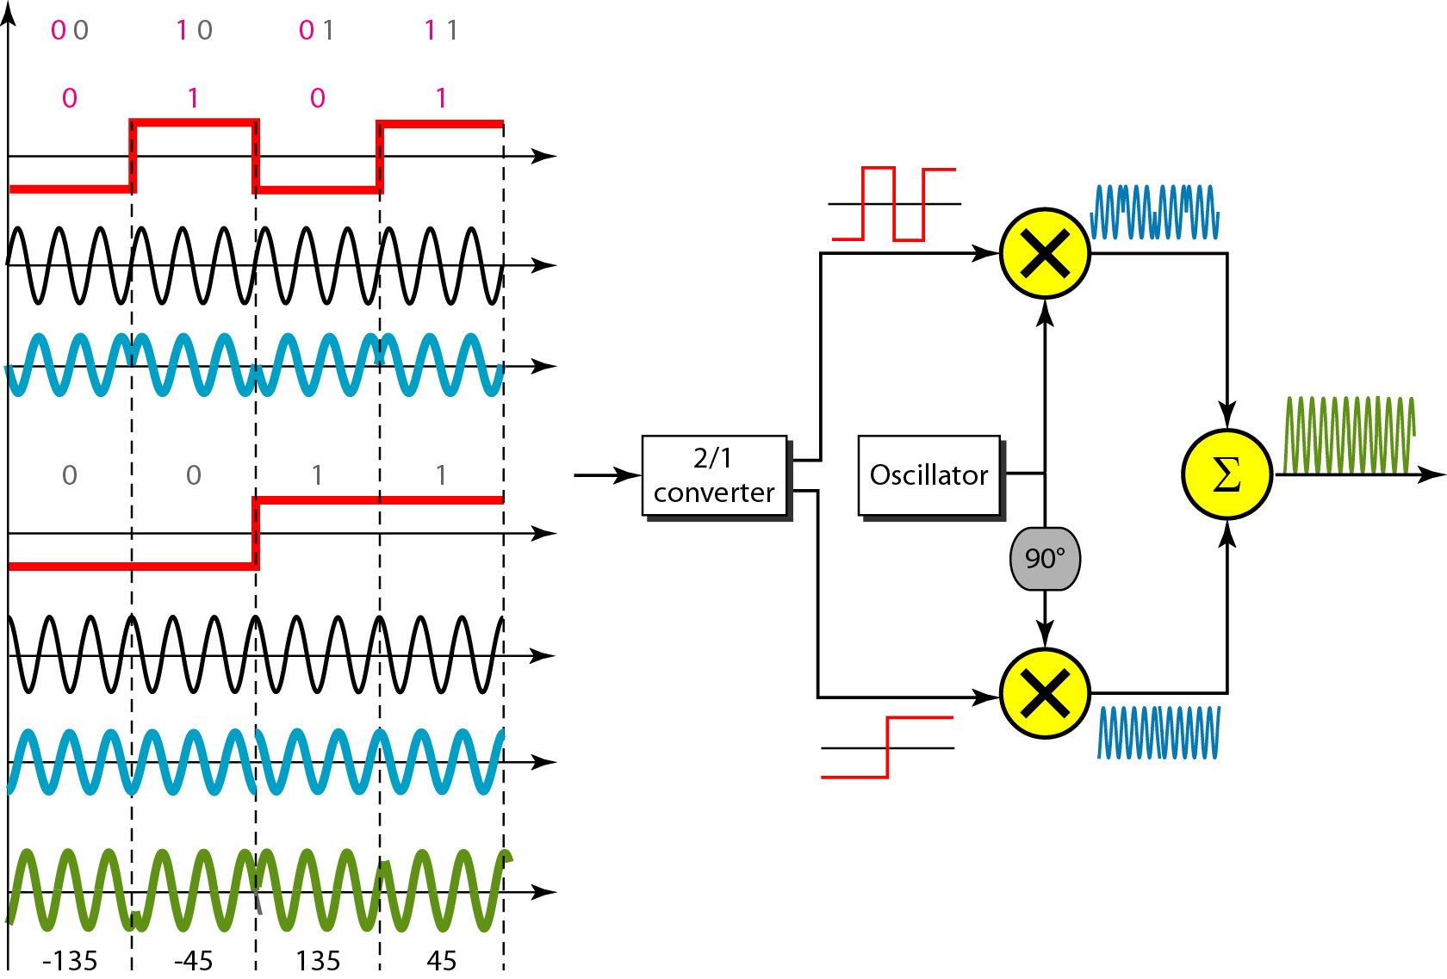
QPSK and its implementation

Slide 43
Find the bandwidth for a signal transmitting at 12 Mbps for QPSK. The value of d = 0.
Solution
For QPSK, 2 bits is carried by one signal element. This means that r = 2. So the signal rate (baud rate) is S = N × (1/r) = 6 Mbaud. With a value of d = 0, we have B = S = 6 MHz.

Slide 44
Note
Quadrature amplitude modulation is a combination of ASK and PSK.

Slide 45
MULTIPLEXING
Whenever the bandwidth of a medium linking two devices is greater than the bandwidth needs of the devices, the link can be shared.
Multiplexing is the set of techniques that allows the (simultaneous) transmission of multiple signals across a single data link.
As data and telecommunications use increases, so does traffic.
Frequency-Division Multiplexing
Wavelength-Division Multiplexing
Synchronous Time-Division Multiplexing
Statistical Time-Division Multiplexing

Slide 46
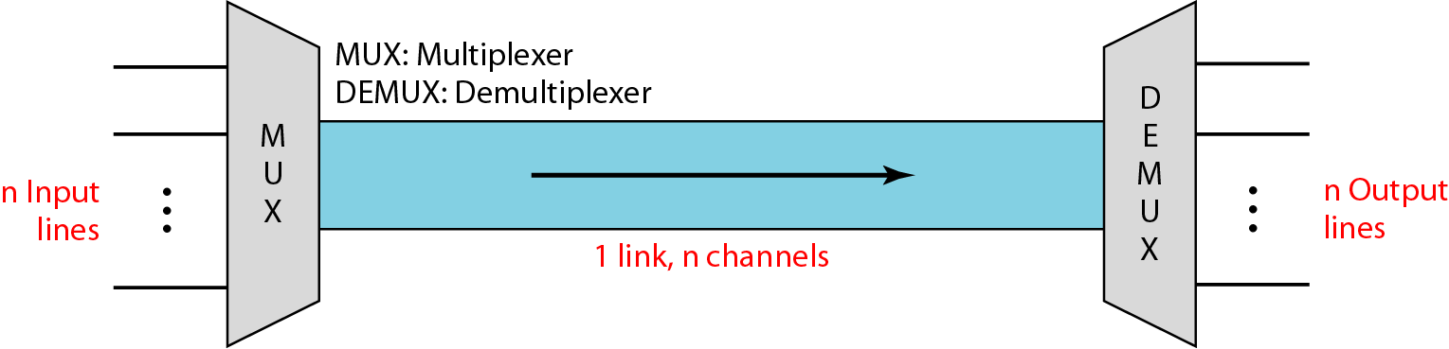
Dividing a link into channels

Slide 47
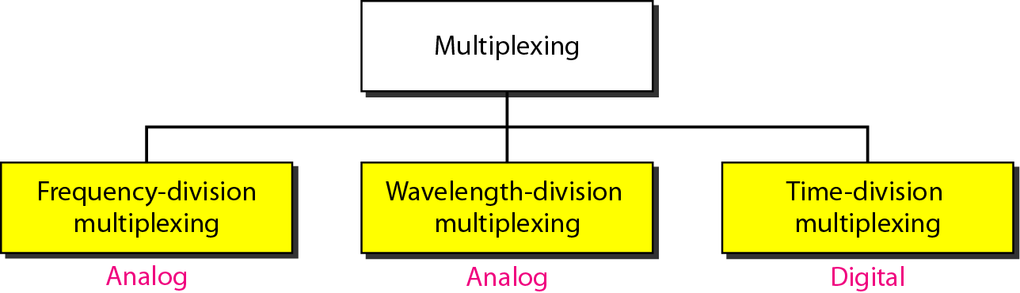
Categories of multiplexing

Slide 48
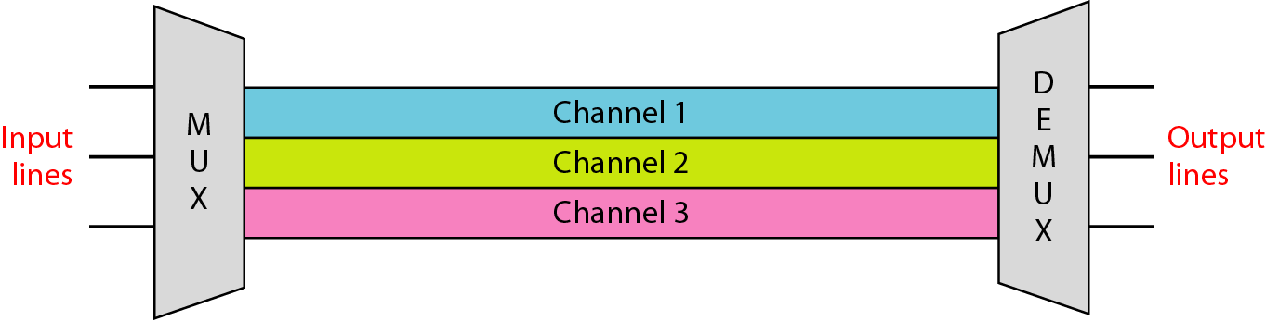
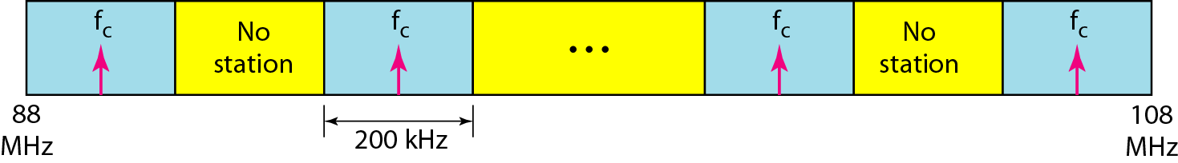
Frequency-division multiplexing (FDM)

Slide 49
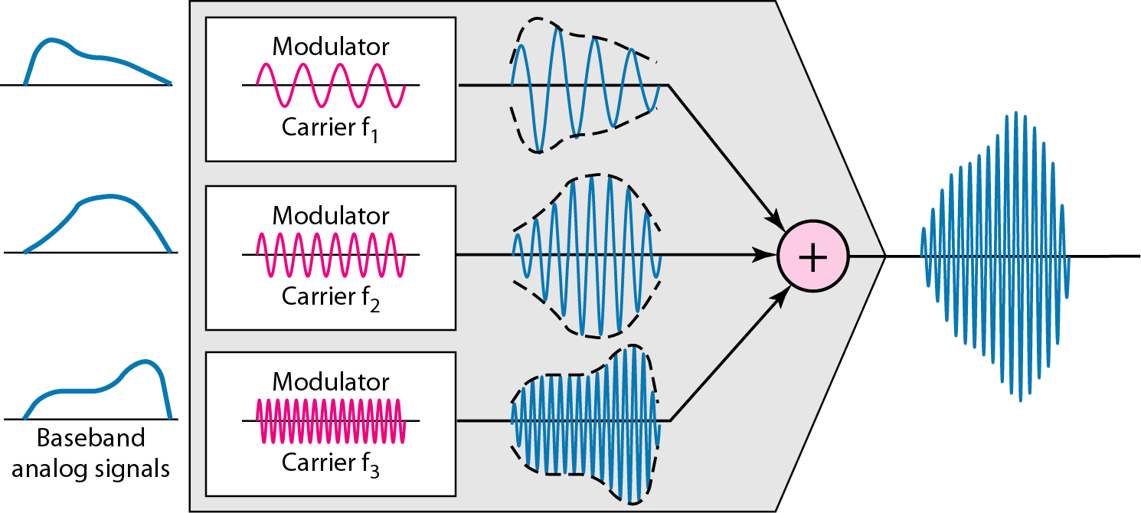
FDM Process

Slide 50
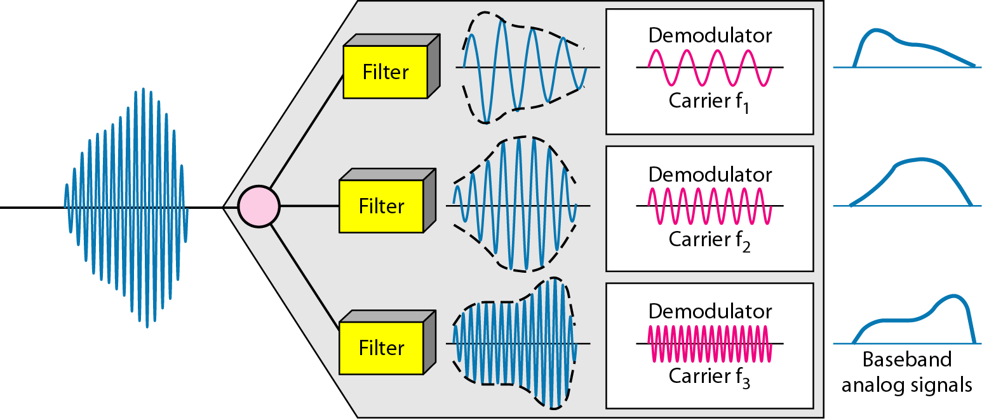
FDM demultiplexing

Slide 51
Assume that a voice channel occupies a bandwidth of 4 kHz. We need to combine three voice channels into a link with a bandwidth of 12 kHz, from 20 to 32 kHz. Show the configuration, using the frequency domain. Assume there are no guard bands.
Solution
We shift (modulate) each of the three voice channels to a different bandwidth, as shown in Figure. We use
the 20 to 24 kHz bandwidth for the first channel,
the 24 to 28 kHz bandwidth for the second channel, and
the 28 to 32 kHz bandwidth for the third one.
Then we combine them.

Slide 52
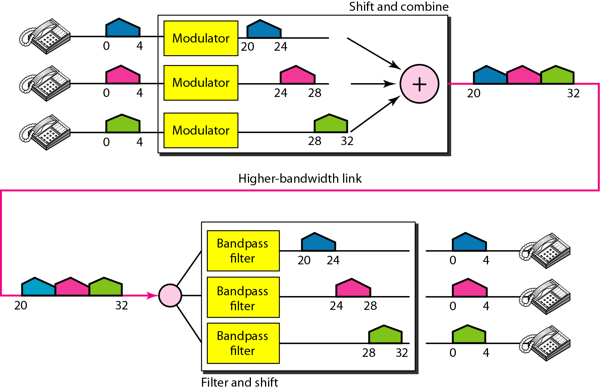
Figure 6.6 Example 6.1

Slide 53
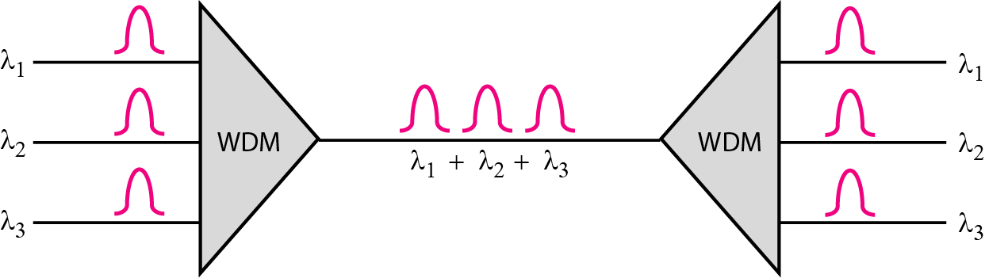
Wavelength-Division Multiplexing (WDM)

Slide 54
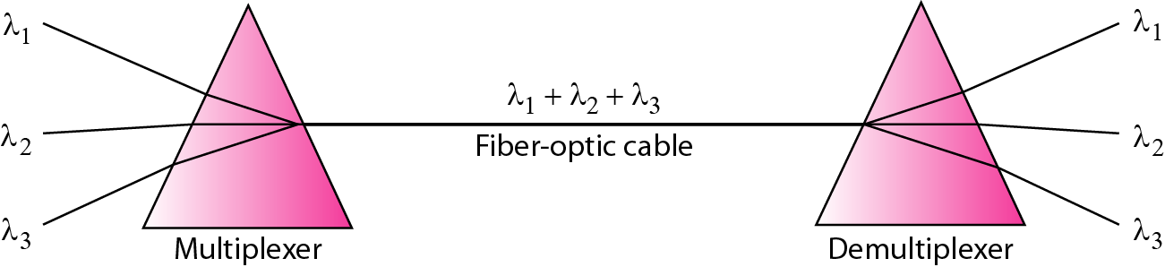
Prisms in wavelength-division multiplexing and demultiplexing

Slide 55
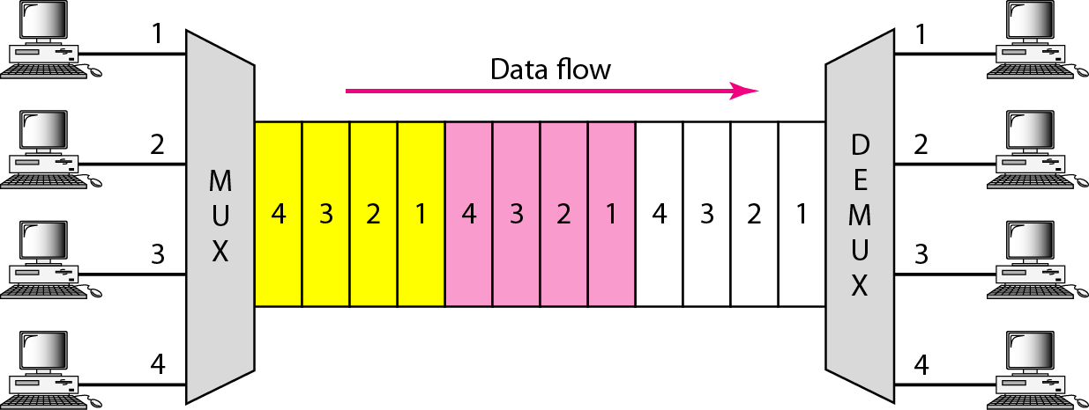
Time Division Multiplexing (TDM)

Slide 56
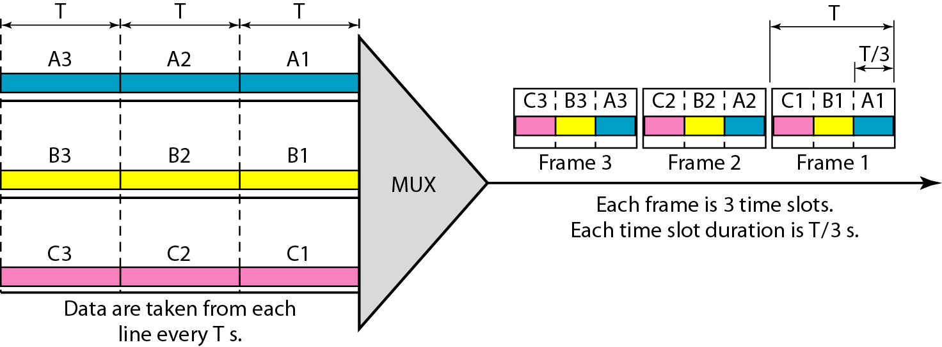
Synchronous Time-Division Multiplexing

